Slide 1
Motorola Sales Dashboard
Deepali Rai

Slide 2
Objective:
To design an interactive Power BI dashboard that helps business stakeholders analyze sales performance, customer ratings, and payment patterns across cities and mobile models.
Key Performance Indicators (KPIs):
💰 Total Sales: ₹291 Million
📦 Total Quantity Sold: 19K
💳 Total Transactions: 4K
📈 Average Sales: ₹40K
Additional Focus:
City-wise performance
Model-wise sales distribution
Payment method trends
Customer satisfaction insights

Slide 3
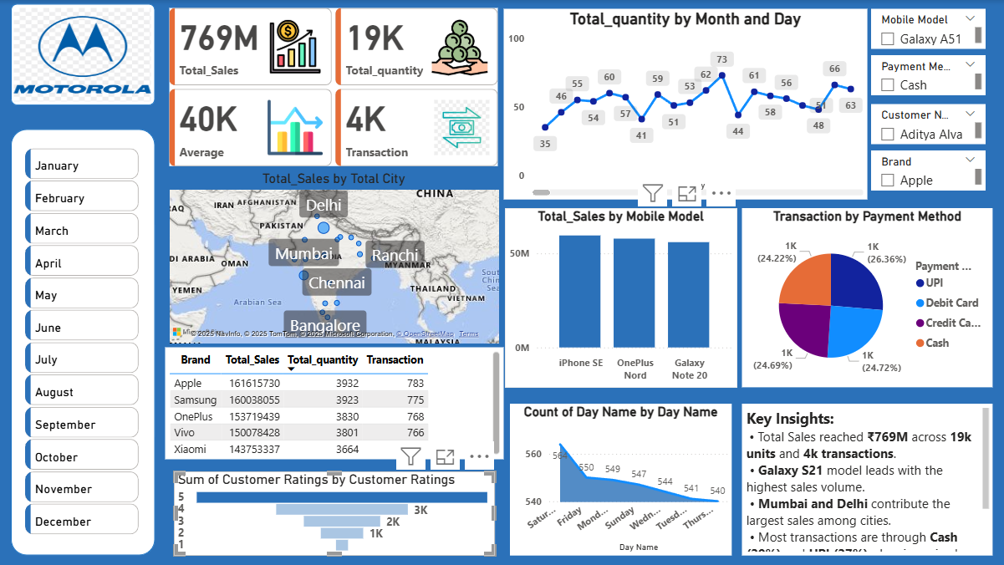
Dashboard Overview

Slide 4
Dashboard Overview and Key Insights
Key Insights:
📱 Galaxy S21 leads total sales across all models.
🏙️ Mumbai and Delhi are top-performing cities in total revenue.
💸 Cash (29%) and UPI (27%) are the most preferred payment methods.
🌟 Majority of customers rated products 4 or 5 stars, indicating strong satisfaction.
📅 Sales remain consistent through the month, with slight spikes on specific days.
Recommendations:
Focus promotional efforts on top-selling cities and high-demand models.
Strengthen digital payment incentives to promote UPI and cards.
Maintain high customer service standards to sustain positive ratings.
Use insights to forecast demand and optimize inventory in key cities.
Dashboard Highlights:
Created using Power BI with interactive slicers for Month, Brand, Payment Method, Model, and Customer Name.
Includes time-series analysis showing sales quantity by month and day.
Map visualization displays top-performing cities (Delhi, Mumbai, Bangalore).
Bar and pie charts show product-wise and payment-wise analysis.
Ratings visualization highlights customer satisfaction levels.

